Slide 1

RUNGTA COLLEGE OF DENTAL SCIENCES & RESEARCH
ANTIGEN
DEPARTMENT OF MICROBIOLOGY

Slide 2
Specific learning Objectives
At the end of this presentation the learner is expected to know ;
Core areas* | Domain ** | Category #
Definition & Classification | Psychomotor | Must know
Mechanism & Factors | Cognitive | Desired to know
Allergens & Adjuvants | Cognitive | Nice to know
Clone Selection Theory | Affective | Nice to know

Slide 3
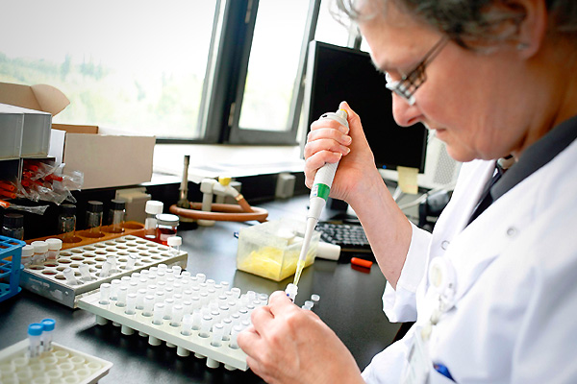
Table of Content
Introduction
Definition
Classification
Td & Ti Antigens
Allergens & Adjuvants

Slide 4
Antigen

Slide 5
Part I Antigen and its characteristics
I. Definition of antigen
Antigen: Those substances that can induce a specific immune response and specifically bind products of immune response in vitro or in vivo.
. Antigen
. Tolerogen
. Allergen

Slide 6
II. Characteristics of Ag
1. Immunogenicity
The ability of antigen which can stimulate the immune system of individual to induce a specific immune response.
2. Immunoreactivity
The ability of antigen which can combine with corresponding Ab or sensitized T lymphocyte.

Slide 7
III. Structure of antigen
hapten and carrier
Hapten: Only possess immunoreactivity
Carrier: Enhance the immunogenicity of hapten
Immunogens :possess both characteristics
Hapten +carrier complete antigen(immunogens)

Slide 8
Part II Factors of affecting immunogenicity of antigen
I. Factors related to antigen
1. Foreignness
According to Burnet clone selection theory , foreignness means substances that never contact with lymphocytes in embryo period.

Slide 9
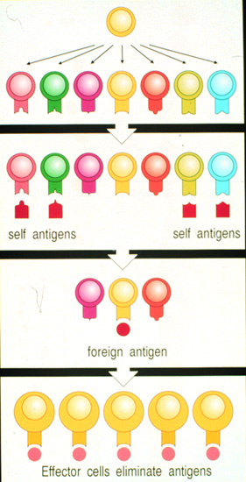
Various clones
Clone deletion
birth
Clone selection

Slide 10
Clonal selection theory
There are various lymphocyte clones, each clone only bears a unique type of Ag receptor
The clones of lymphocyte that can recognize self-Ags will be destroyed or learn to tolerance to self Ags (forbidden clones) at the early stage of their development---clone deletion
The clones of lymphocytes that can be interacted with corresponding Ag (by Ag receptors ) can be selected and induced to activation, proliferation , produce Ab and specific memory cells---clone selection
Forbidden clones can be revival and cause autoimmunity.

Slide 11
(1) Xeno-substances
---- Various pathogens and their products, xeno- proteins, etc.
(2) Allo-substances
---- ABO blood type, HLA, et al.
(2) Self component
Release of sequestered antigen------
Such as lens protein, sperm etc.
Change of molecular structure of auto-tissues

Slide 12
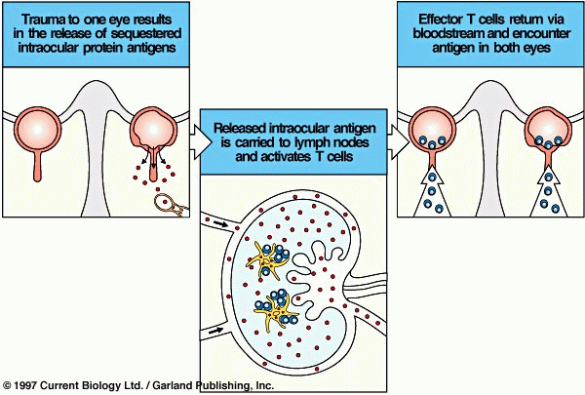

Slide 13
2. Physical and chemical nature of antigen
(1) Molecular weight( >10.0 kD)
more stationary
more surface structure for lymphocytes to recognize

Slide 14
(2) Chemical composition and structure
Protein>polysaccharides, nucleic acids, lipids
(Protein containing aromatic amino acid,such as tyrosine)
(3) Physical nature
Polymer > Monomer
Cycle molecule >linear molecule
Particulate Ag> soluble Ag

Slide 15
3. Conformation and Accessibility
Polymer lysine
Polymer alanine
Tyrosine
Glutamic acid
The position and space of amino acid residues
are related to immunogenecity of antigen

Slide 16
II. Factors related to host
1. Genetic backround (Species, Individual)
2. Age,Sex and healthy condition

Slide 17
III. Methods of immunization
1. Dosage of antigen, times of injection
2. Pathways of immunization
(intracutaneous>subcutaneous>intravenous>oral)
3. Adjuvant

Slide 18
Part III Specificity and cross reaction of antigen
I. Specificity
Exist in both immunogenecity and immunoreactivity
The basis of immunologic diagnosis and immunologic therapy

Slide 19
1. Antigen determinants(epitope)
The portion of antigen molecules which
can be specifically bound by antibody or
antigenic receptor of lymphocytes.
Polypeptide antigen----5-23 amino acid residues
Polysaccharide antigen----5-7 monosaccharides
Nuclear acid antigen----6-8 nucleotide

Slide 20
. Decide the specificity of the antigen
a subtle change(chemical composition, number and conformation) can affect the specificity of Ag.
Antigen determinant is the site of Ag combining with Ab

Slide 21
2. Antigenic valence:
Total number of determinants which can be bound by antibody or antigenic receptor of lymphocytes is called antigenic valence.
Most natural antigens are polyvalence antigen.
Hapen is monovalence antigen.

Slide 22
3. Classification of antigenic determinant
(1)According to the site and structure of Ag determinants
Conformational determinants
Sequential (or linear) determinants

Slide 23
Conformational determinants
Conformational determinants are formed by amino acid residues that aren’t in a sequence but become spatially juxtaposed in the folded protein.
They are normally exist on the surface of antigen molecules.
They are recognized by B cells or antibody.

Slide 24
Sequential (or linear) determinants
Epitopes formed by several adjacent amino acid residues are called linear determinants.
They are exist on the surface of antigen molecules or inside of antigen molecules.
They are mainly recognized by T cells, but some also can be recognized by B cells.

Slide 25
Conformational determinants
Sequential (or linear) determinants
B
B/T
active
degradation

Slide 26
(2)According to types of cells recognizing antigenic determinants
T cell determinants (T cell epitopes)
B cell determinants (B cell epitopes):
Functional determinants
Hidden or Sequestered determinants

Slide 27
Comparison of T cell epitope and B cell epitope
T cell epitope B cell epitope
Structure linear epitope conformational epitope
or linear epitope
Receptor TCR BCR
Nature proteins proteins, polysaccharides
Size 8-23 amino acid residues 5-15 amino acid residues
or 5-7 monosaccharides
or 5-8 nucleotides
Position any part of antigen mostly exist on the surface of
molecules antigen
MHC molecules required not required
Presentation

Slide 28
Functional determinants and sequestered determinants
Functional determinants : The determinants existing on the surface of Ag which can be recognized by BCR or combined with Ab easily.
Immune dominant determinant:Specially important determinant.
Sequestered determinants: The determinants existing inside of Ag which can not be recognized by BCR or combined with Ab easily.

Slide 29
II. Common antigen and cross reaction
1. Common antigen
Different antigens which possess the same or similar epitopes are called common antigen.
2. Mechanism of cross reaction
----Existence of common Ag determinant
Because there are some common antigen determinants existing in different microbes, so the antiserum against one kind of microbe can also react with another microbe,this called cross reaction.

Slide 30
3. Significance:
In clinic, existence of cross reaction may lead to wrong diganosis.

Slide 31
Part IV Classification of Ag
I. According to immunogenicity of antigens:
Antigen
Hapten

Slide 32
II. According to the dependence of T cells when Ags induce humoral immune response
TD-Ag (thymus dependent Ag )
TI-Ag (thymus independent Ag)

Slide 33
1.TD-Ag (thymus dependent Ag )
TD-Ag can stimulate B cell to produce Ab with
the help of T cell
Most of TD-Ag are protein
Have many kinds of determinants
Can induce HI and CMI
Stimulate B cell to produce :IgG, IgM, IgA
Have immune memory

Slide 34
2. TI-Ag (thymus independent Ag)
TI-Ag can stimulate B cells to produce Ab without the help of T cell
Most are polysaccharide
Have more same or repeat determinants
Only induce B cell to produce IgM
Can not induce CMI
No immune memory

Slide 35
III. According to source of antigen
Xenoantigen
Alloantigen
Autoantigen
Heterophile antigens(Forssman antigen)
The common antigen existing different species.

Slide 36
Part V Important antigens in medicine
I. Pathogens and their products
1. Pathogens:such as bacteria et al.
Surface antigen: “Vi” Ag
Somatic Ag: “O” Ag
Flagellar Ag: “H” Ag
Pillus Ag

Slide 37
2. Exotoxin and toxoid
(1) Exotoxin
Produced by G⁺ bacteria
Strong antigenicity and pathogenicity
(2) Toxoid
Under suitable conditions, exotoxin loss its toxicity without affecting its antigenicity, then the exotoxin turned into toxoid
Antitoxin: The antibody produced by exotoxin or toxoid stimulation was called antitoxin.

Slide 38
II. Immune serum of animal
Animal serum contains Abs after
immunized by some Ag
Dual-characteristics
1. Ab
2. Ag

Slide 39
III. Heterophile Ag (forssman Ag)
- common Ags shared by different species
- no specificity of species
- Significance . immunopathology
. Diagnosis

Slide 40
IV. Alloantigen
1. Antigens of red blood cell
ABO system (blood typing)
- very important in transfusion
Rh system (in Chinese >99%RH+)
2. HLA system (Human leukocyte antigen)
- relate to transplantation
- very important in immune regulation

Slide 41
ABO system
Blood antigen antibody in
type on RBC serum
A A anti-B
B B anti-A
AB A,B -
O - anti-A, anti-B

Slide 42
V. Autoantigen
1. Release of sequestered Ag
2. Change of molecular structure of auto-tissues

Slide 43
VI. Tumor antigen
Tumor specific Ag ( TSA)
Only expressed on the tumor cells but normal cells.
Tumor associated Ag (TAA)
Highly expressed on tumor cells but lowly expressed on normal cells,such as AFP,CEA.

Slide 44
Part VI Adjuvants
I. Definition
Adjuvant is certain substance which can non-specifically enhance the Immune response or change the type of Immune response when it is injected before or together with the antigens.

Slide 45
II. Classification of adjuvant
organic adjuvants: BCG
inorganic adjuvants: Al(OH)₃
synthesized adjuvants: polyI:C
complex adjuvants

Slide 46
Common adjuvant:
Incomplete Freund’s adjuvant
Complete Freund’s adjuvant

Slide 47
III. Mechanisms of adjuvant
Change the chemical and physical characteristic of Ag
Improves the Ag process and presentation ability of macrophages
Non-specifically stimulate proliferation of lymphocytes

Slide 48
TAKE HOME MESSEGE/ FOR THE TOPIC COVERED (SUMMARY)
Antigen and its characteristics
Factors of affecting immunogenicity of antigen
Specificity and cross reaction of antigen
Classification of antigen
Important antigens in medicine
Adjuvants

Slide 49
REFERENCES
Microbiology – Prescott, et al.
Microbiology – Bernard D. Davis, et al.
Clinical & Pathogenic Microbiology – Barbara J Howard, et al.
Immunology an Introduction – Tizard.
Immunology 3rd edition – Evan Roitt, et al.
Medical Microbiology – Greenwood
Textbook of Microbiology – Ananthnarayan
The short Text Book of Microbiology – Satish Gupte

Slide 50
Question & Answer Session

Slide 51
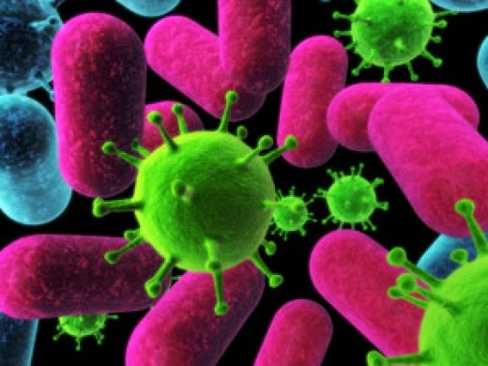

Slide 52
THANK YOU

